Slide 1
Feed Forward Network
Introduction to neural networks - AS 04
By: Nadav Porat

Slide 2
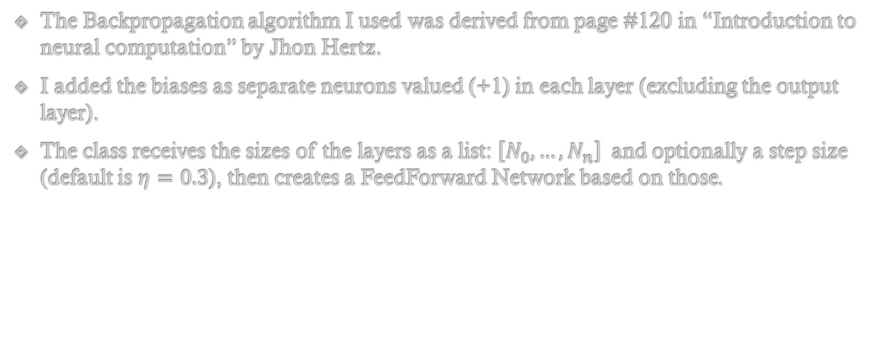
Notes
The Backpropagation algorithm I used was derived from page #120 in “Introduction to neural computation” by Jhon Hertz.
I added the biases as separate neurons valued (+1) in each layer (excluding the output layer).
The class receives the sizes of the layers as a list: $\left[N_{0}, …, N_{n}\right]$ and optionally a step size (default is $η=0.3$), then creates a FeedForward Network based on those.

Slide 3
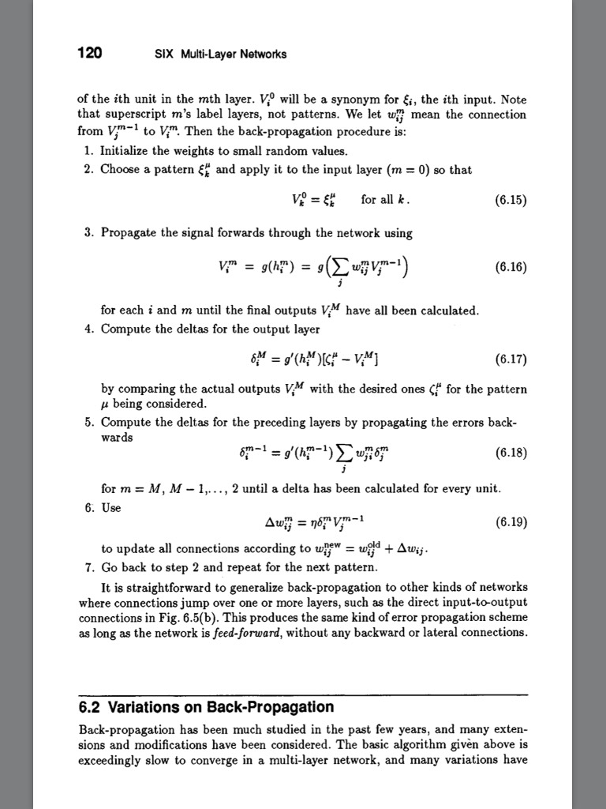
Notes

Slide 4



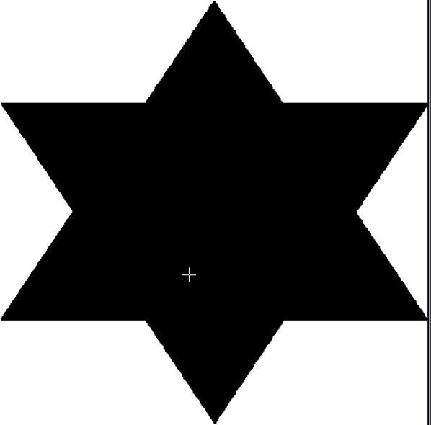

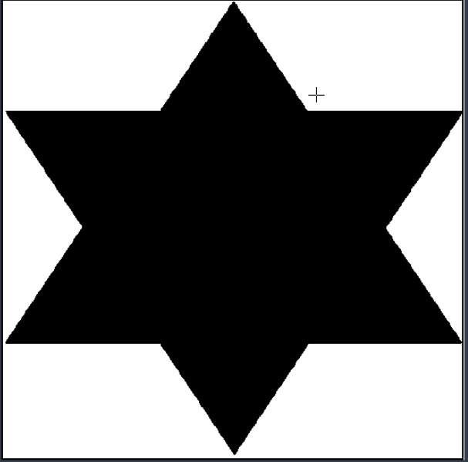
Perceptron Vs Multi-Layers
Q1 – Star Network
The multi-layered net used is built form the following layers [2, 6, 1], the perceptron is [2, 1].
The networks are trained to produce (+1) if the point is in the star and (0) if it is outside.

Slide 5
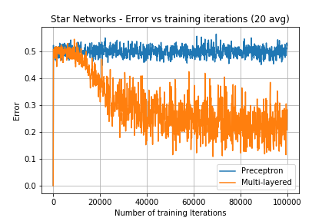
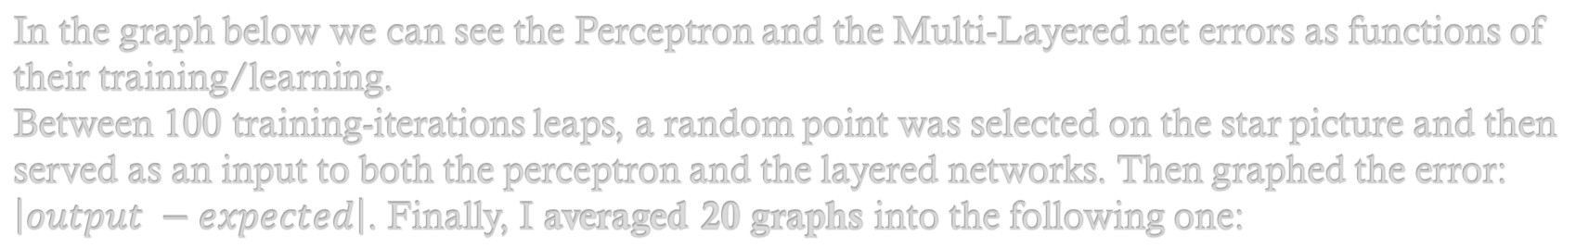
Perceptron Vs Multi-Layers
Q1 – Star Network
In the graph below we can see the Perceptron and the Multi-Layered net errors as functions of their training/learning.
Between 100 training-iterations leaps, a random point was selected on the star picture and then served as an input to both the perceptron and the layered networks. Then graphed the error: $\left|output −expected\right|$. Finally, I averaged 20 graphs into the following one:

Slide 6
Perceptron Vs Multi-Layers
Q1 – Star Network
We can see that the Perceptron is basically unchanging at 50% error, and the Multi-Layered network is “learning” and stabilize at ~25% error.

Slide 7



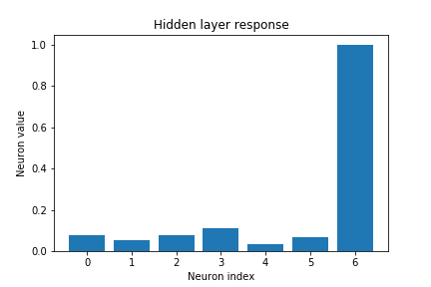
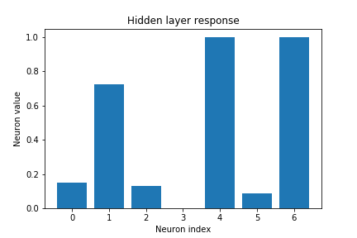
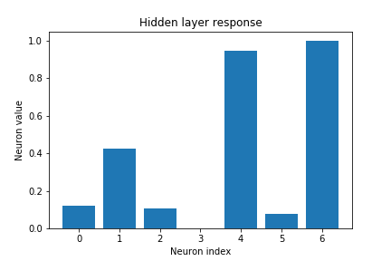
Hidden layer analysis
Q1 – Star Network
I selected squares on the star picture and propagated their points on the Multi-Layered net. Then I averaged the results of the hidden layer in nearby squares (notice that the two on the right are similar):

Slide 8
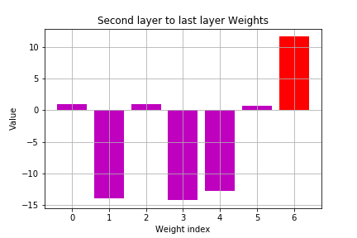
Hidden layer analysis
Q1 – Star Network
If we’ll look at the weights, we can see that the bias (in red) controls everything. If all the neurons get a low value (as in the left example), the bias gets dominant and we get a +1. If the other neurons are active, they deduce from the bias and we’ll get a 0.

Slide 9
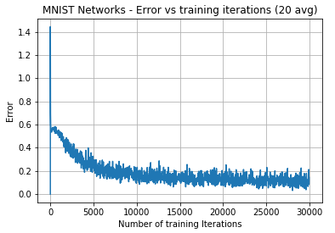
MNIST Network
Q2 – MNIST Network
The MNIST network I created is built from the following layer [28*28, 16, 16, 10].
The output is a 1x10 array. The value of each index is the probability of the answer being that number.
The following graph describes the net’s error in recognition of a digit from the MNIST test set, as a function of the training iterations the net had gone through. The graph is averaged over 20 runs.

Slide 10
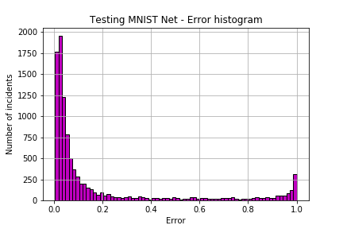
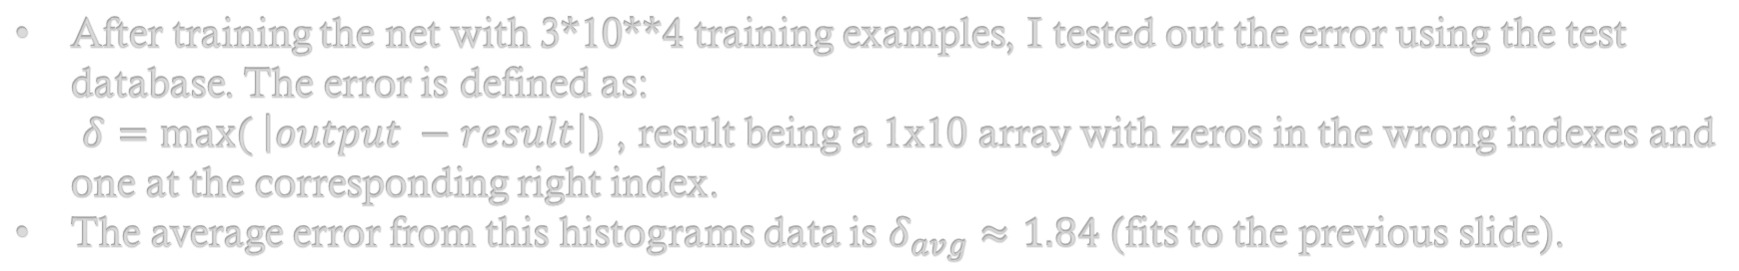
MNIST Network - Error
Q2 – MNIST Network
After training the net with 3*10**4 training examples, I tested out the error using the test database. The error is defined as: $δ=max⁡( \left|output −result\right|)$ , result being a 1x10 array with zeros in the wrong indexes and one at the corresponding right index.
The average error from this histograms data is $δ_{avg}≈1.84$ (fits to the previous slide).

Slide 11
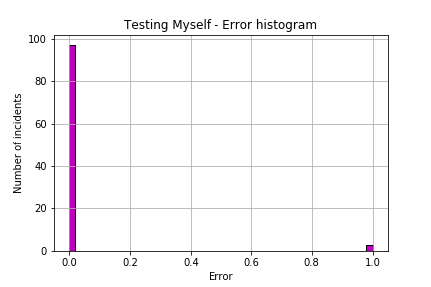
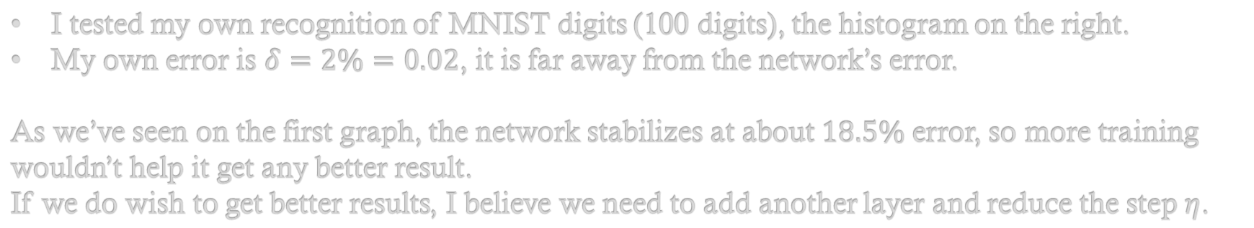
MNIST Network - Error
Q2 – MNIST Network
I tested my own recognition of MNIST digits (100 digits), the histogram on the right.
My own error is $δ=2\%=0.02$, it is far away from the network’s error.
As we’ve seen on the first graph, the network stabilizes at about $18.5\%$ error, so more training wouldn’t help it get any better result.
If we do wish to get better results, I believe we need to add another layer and reduce the step $η$.

